Slide 1

Outcomes and follow-ups from UN 2023 Water Conference (including EW4All) and WMO contribution to the WCC
Hydrological Assembly
Dr. Stefan Uhlenbrook
Director Hydrology, Water Resources and Cryosphere
30 May 2023

Slide 2

WMO Vision and Strategy for Hydrology and its Associated Plan of Action
Vision Statement
By 2030 a cooperative global community is successfully addressing the growing challenges related to
hydrological extremes,
water availability and quality, and
food security,
by advancing operational hydrology through
enhanced science,
infrastructure,
capacity-building and related services,
in the context of sustainable development and enhanced resilience.
Plan of Action Output A.1
Increased presentation/communication and understanding of value proposition, benefits and risk analysis, and value of hydrological services to foster understanding by ministries and governments
 | 2

Slide 3
WMO Resolution 25 (CG-18) in 2019
Basis for WMO Plan of Action for Hydrology - eight Long-term Ambitions:
No one is surprised by a flood
Everyone is prepared for drought
Hydro-climate and meteorological data support the food security agenda
High-quality data supports science
Science provides a sound basis for operational hydrology
We have a thorough knowledge of the water resources of our world
Sustainable development is supported by hydrological information
Water quality is known
Notes:
Decides to prepare a Plan of Action to fulfill the following Long-term Ambitions below:

Slide 4
UN 2023 Water Conference from 22-24 March, UN Headquarters in New York, USA
First global intergovernmental attempt to address the world’s water problems after 46 years.
The outcomes of the Conference:
Summary of the Conference proceedings (still to be released)
Water Action Agenda: more than 700 commitments, pledges and actions by Governments and stakeholders towards achieving SDG 6 and other water-related goals and targets.
The Conference was attended by >2500 participants (representatives of Member States, intergovernmental organizations, UN enteties and other stakeholders).
11 Heads of State or Government and some 120 ministers
166 Member States delivered a statement
 | 4

Slide 5
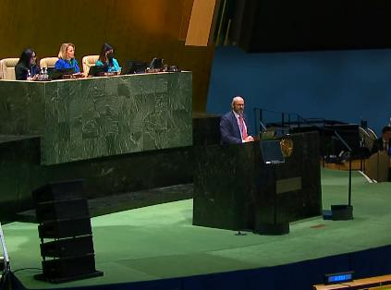
WMO Activities -> Visibility & Impact
WMO submitted three commitments:
Better global water information through the Global Hydrological Status and Outlook System (HydroSOS) & Reporting
Enhancing earth system observations, monitoring and forecasting for floods and droughts to ensure early warnings for all (EW)
Scaling up people-centered flood and drought Early Warning Systems
High visibility/impact through Interactive Dialogue 3, flagship event on EW4All with focus on floods and droughts, co-organizing or participating in over 40 events, delivering statements at the General Assembly, as well as Interactive Dialogues 4 and 5.
 | 5

Slide 6
Conference concluded with following global needs with direct or indirect implications for WMO
Integrated water and climate policy at national and global levels by 2030.
Operational Global Water Information System to support water, climate and land management for socioeconomic resilience, ecological sustainability and social inclusion by 2030.
Early Warnings for All to help safeguard lives and property by 2027.
Overcoming the dependence on ever-rising water consumption for providing food, nutrition and power.
Re-defined financial principles to make our economies water-, climate-, land-, and ecosystems-smart and people centric.
Global Water Education Network to build the capacity of institutions and people, especially to support developing countries.
Inclusive, comprehensive transboundary water agreements to support countries, on the basis of the 1992 Convention on the Protection and Use of Transboundary Watercourses and International Lakes (Water Convention) and the 1997 Convention on the Law of the Non-navigational Uses of International Watercourses (Watercourses Convention).
Institutional water architecture to support transformation: a board of UN agencies under the leadership of the UN Secretary-General, managed by a UN Special Envoy for Water, supported by a reformed UN-Water coordinating body and an independent scientific and advisory panel, in addition to the arrangement for discussing water policy at the United Nations in New York to be developed by the General Assembly.
Intergovernmental processes on water to be convened on a regular basis.
 | 6

